Slide 1


MARYAM KHALID
01-134241-040
SABAHAT
01-134241-041
ROHAN MUNIR
01-134241-040
BUBBLE SORT

Slide 2
INTRODUCTION TO THE BUBBLE SORT
Implemented in COAL to compare and exchange adjacent elements in an array stored in memory.
Registers such as SI, DI, CX, and DX are used to hold memory addresses and loop counters.
The CMP instruction compares two values.
MOV or XCHG instructions perform the data transfer.
Looping is controlled using DEC, INC, and LOOP instructions.

Slide 3

GOALS AND OBJECTIVES
Understand how Bubble Sort works step-by-step.
Learn how adjacent element comparison leads to sorting.
Identify how loops control sorting passes.
Apply sorting logic using Assembly (COAL) instructions.
Analyze the algorithm’s efficiency.
Visualize sorting through a flowchart and trace example.

Slide 4

WORKING EXAMPLE
Array: [5, 3, 8, 1, 2]
Pass 1: 3 moves ahead of 5, then 1 moves ahead of 8, etc. → largest (8) moves to end
Pass 2: Next largest moves to correct position
Continue until fully sorted
Final Result: [1, 2, 3, 5, 8]

Slide 5
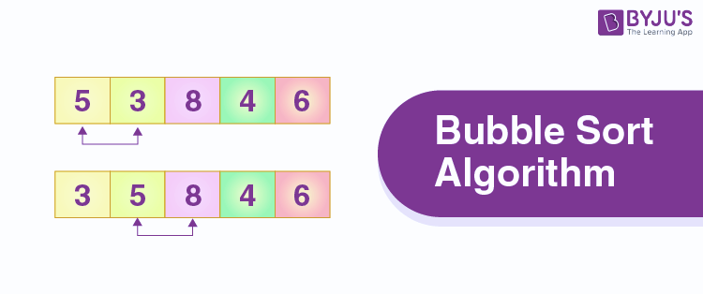
Array stored in memory
SI and DI used as pointers (or index counters)
CMP instruction compares two elements
If arr[j] > arr[j+1]:
Use XCHG or temporary register to swap
Outer loop decreases range each pass
BUBBLE SORT IN COAL
(ASSEMBLY VIEW)

Slide 6
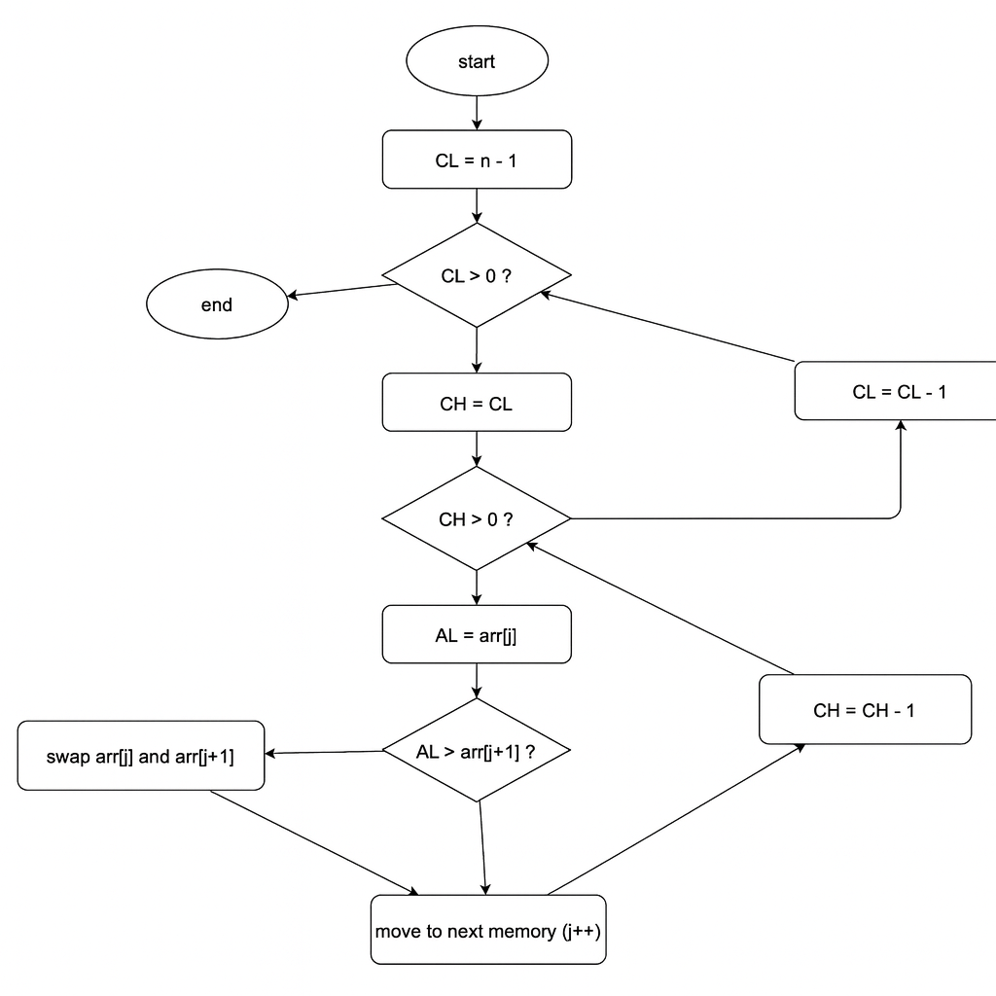

FLOWCHART

Slide 7
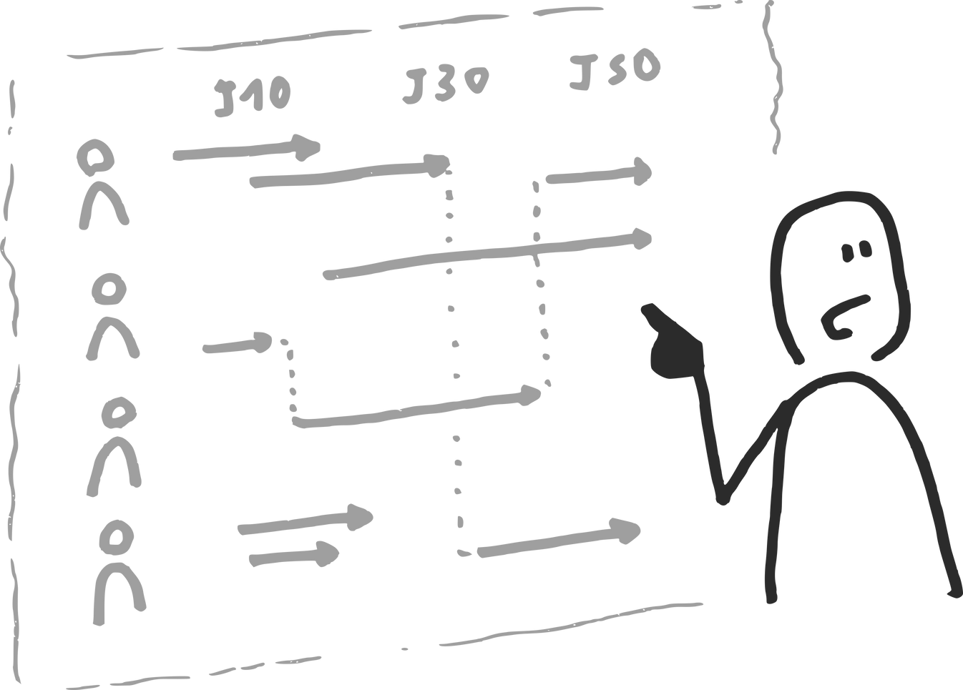
FLOW EXPLANATION
Compare neighbors: Start at the beginning of the list and compare the first two elements.
Move forward: Go to the next pair and repeat the compare-and-swap process until you reach the end of the list.
01
03
Swap if needed: If the first element is bigger than the second, swap them so the bigger one moves toward the end.
Repeat: Keep doing this for the whole list until no swaps are needed in a full pass-- then the list is sorted.
02
04

Slide 8
&
DISADVANTAGES
ADVANTAGES
Very easy to implement.
Simple logic and beginner-friendly.
Good for small datasets.
Works well in environments like Assembly teaching.
Slow for large arrays.
Not great for real worls use.
Excessive number of swaps.
Poor performance compared to QuickSort, MergeSort etc.

Slide 9
CONCLUSION
Easy to implement in Assembly, good for beginners learning low-level programming.
Uses simple instructions (CMP, MOV, INC, DEC, JUMP), making instruction flow clear.
Helps understand loops, counters, and register usage (CL, CH, SI).
Reinforces memory addressing by comparing and swapping adjacent values.

Slide 10
THANK YOU!

